Slide 1

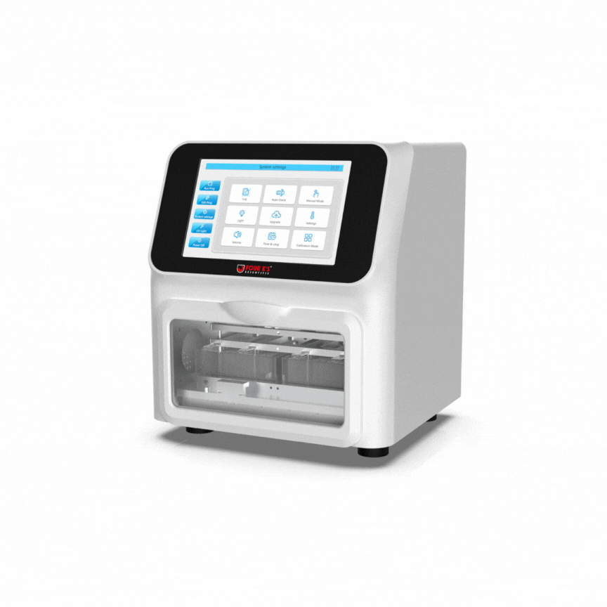
MultiEX32: Automated Nucleic Acid Extraction System
System Specifications
Sample types | Serum, Plasma, Saliva, and other body fluids
Reaction Volume | 50μl-1000μl
Sample Throughput | 1-32
Magnetic beads recovery rate | 96%
Extraction variation | CV＜3%
Heating temperature | Adjustable from room temperature to 125°C/257°F
Reagent type | Magnetic bead-based open-source reagents
Extraction time | 20min-40min/run (depending on reagent types and volumes)
Well plate | 96 deep well plate
Mixing Intensities | Adjustable : 8 Levels
Max. Stirring Speed | 10Hz
Display | 10-inch Colour touch screen
Memory | >500 programs
Program management | Add, edit, and delete programs
UV lamp | Yes
Light | Yes
Device size | 349× 325× 390(mm)
Device weight | 25kg
Notes:
UV decontamination
System Check Feature
Plate drawer
Audible alarm
Replace motor after 50,000 runs (1,600,000 tests)

